Slide 1
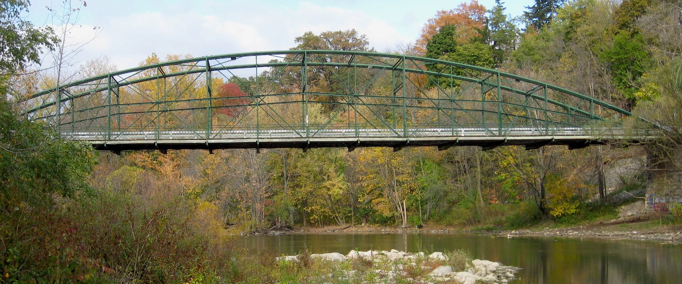
When There Are No Bridges: Hacking Our Way Into a Resource Sharing Ferry System
Alex Fletcher, Randy Oldham, Sabina Pagotto
Notes:
Blackfriars Street Bridge
London, Ontario crossing North Thames River. Built 1875.
Oldest wrought iron bridge in North America still used for vehicular traffic.
Single-lane vehicles, bicycles and pedestrians
Copyright Alethe, CC BY-SA 3.0 2007
https://en.wikipedia.org/wiki/Blackfriars_Street_Bridge
https://commons.wikimedia.org/wiki/File:Blackfriars_Bridge_from_South_riverbed.jpg

Slide 2
Table of contents
Background
Implementing an AFN
1
2
Hacking Alma Resource Sharing
What have we learned?
3
4
Only minimal romanticization of railroads
"Sure, you can totally do things this way!" Famous last words.
Pretty sure it was never intended to be used this way
Nothing works the way you think it will.
Alex

Slide 3
Introduction
Sabina
Alex
Randy
You'll have to excuse me, I'm not at my best
--Spirit of the West, "Home for a Rest"

Slide 4
1
Background
Only minimal romanticization of railroads
Sabina

Slide 5
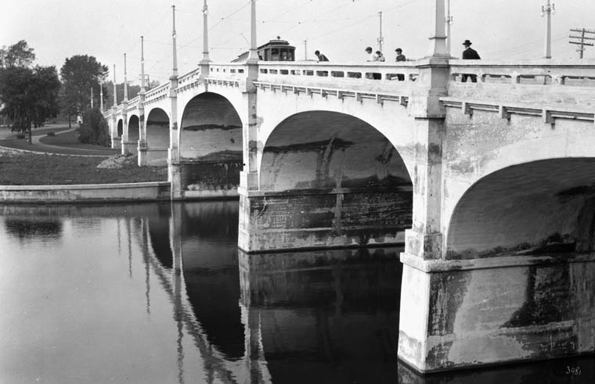
So, we're Canadian.
Forgive us if we say "En Zed" a bunch of times. (Sorry, Eh?)
But also...
We have a whole bunch of thoughts about bridges. And ILL infrastructure.
I drew a map of Canada, O Canada. --Joni Mitchell, "A Case of You"
Notes:
Bank Street Bridge
Ottawa, Ontario, built 1912. Crosses the Rideau Canal in downtown Ottawa.
Public Domain by William James Topley, August 1916.
https://en.wikipedia.org/wiki/Bank_Street_Bridge
https://en.wikipedia.org/wiki/William_James_Topley
https://commons.wikimedia.org/wiki/File:Bank_Street_bridge_old.jpg

Slide 6
Canada is really big.
Infrastructure is a part of our heritage.
Telecommunications
Railroads
The telephone was invented by a Canadian. Blackberry is Canadian. The first Transatlantic telegram was sent from Newfoundland!
Building a railroad across the country was one of the key pieces of Confederation (i.e. the thing that made us a country.)
We've got a whole lot of land. --The Arrogant Worms, "Canada's Really Big"

Slide 7
Interlibrary Loan and Infrastructure
Technical Infrastructure:
Generic Script Messaging
Physical infrastructure:
Inter-University Transit System (IUTS)
The Ontario Council of University Libraries (OCUL) was founded in 1967. The first thing we did was lease a bunch of station wagons that would drive between Ontario universities with ILL books. IUTS is still running today.
(Canada Post also has a pretty sweet Library Book shipping rate.)
One of the first-ever ILL messaging protocols, Generic Script Messaging (GSM) was developed in Canada in the 1980s. Generic Script is machine readable, human readable, and English/French bilingual... and it's still in use today!
They looked in the future, and what did they see? They saw an iron road running from the sea to the sea.
--Gordon Lightfoot, "Canadian Railroad Trilogy"

Slide 8
<3 VDX <3
Virtual Document eXchange: originally created by a British company (Fretwell Downing), later acquired by OCLC
OCUL has been running a locally hosted VDX instance (RACER) since 2003
VDX includes patron search & request interface, within-consortium lending, and outside consortium borrowing and lending
One of VDX's strengths is interoperability
  Supports multiple library symbols
  Supports ISO, GSM, and more
Hello out there, we're on the air.
--Stompin' Tom Connors, "The Hockey Song"

Slide 9
ILL in Canada, circa 2019
The four Canadian academic library consortia have an agreement for no-cost ILL:
OCUL, representing Ontario (VDX)
PBUQ (formerly BCI/CREPUQ), representing Quebec (VDX)
CAAL, representing Atlantic Canada (mostly Relais)
COPPUL, representing Western Canada (mostly Relais)
Messaging was easy. Loans were free. No need to worry about expensive international shipping or customs.
Those were the best days of my life.
--Bryan Adams, "Summer of '69"

Slide 10
And then came Alma...
I left it all behind to seek a Northwest Passage to the sea.
--Stan Rogers, "Northwest Passage"
Notes:
Become a person who doesn't trust anything. Especially not written documentation. Not even "trust but verify". Don't trust at all. Test everything yourself. Does it even exist if you didn't see it with your own two eyes? Alma Resource Sharing documentation is funding my therapist's mortgage, is what I'm saying.

Slide 11
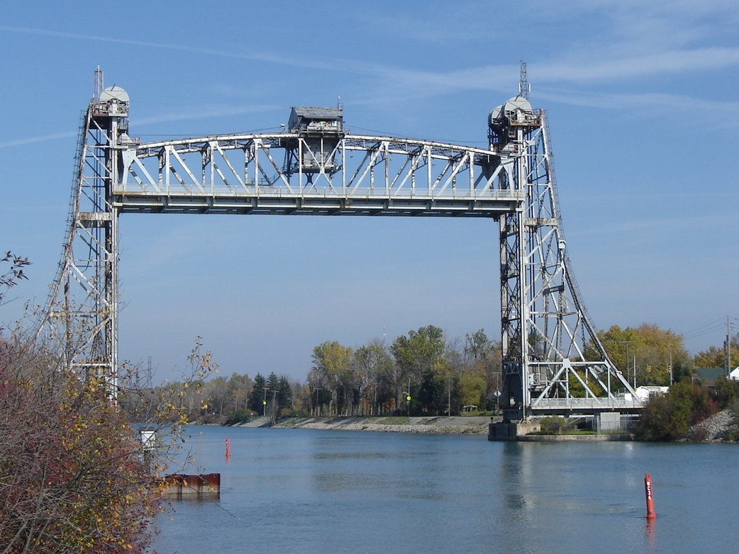
2
Implementing an AFN
"Sure, you can totally do things this way!" Famous last words.
Randy
Notes:
Allanburg Bridge 11
Allanburg, Ontario over the Welland Canal. Built 1932
Public Domain image by Qviri (circa 2005)
https://en.wikipedia.org/wiki/Welland_Canal_Bridge_11
https://commons.wikimedia.org/wiki/File:Allanburg_Bridge.jpg

Slide 12
What is an AFN?
Need an NZ
Centralize
Walk-in
Sharing
Formats
Caring
Network Zone Required
Can centralize config in the NZ
Permits unmediated walk-in borrowing
Shared patrons & policies
Shared Resources
Physical only, no digital
Because Sharing is Caring
What's this river that I'm in?
--The Tragically Hip, "New Orleans is Sinking"

Slide 13
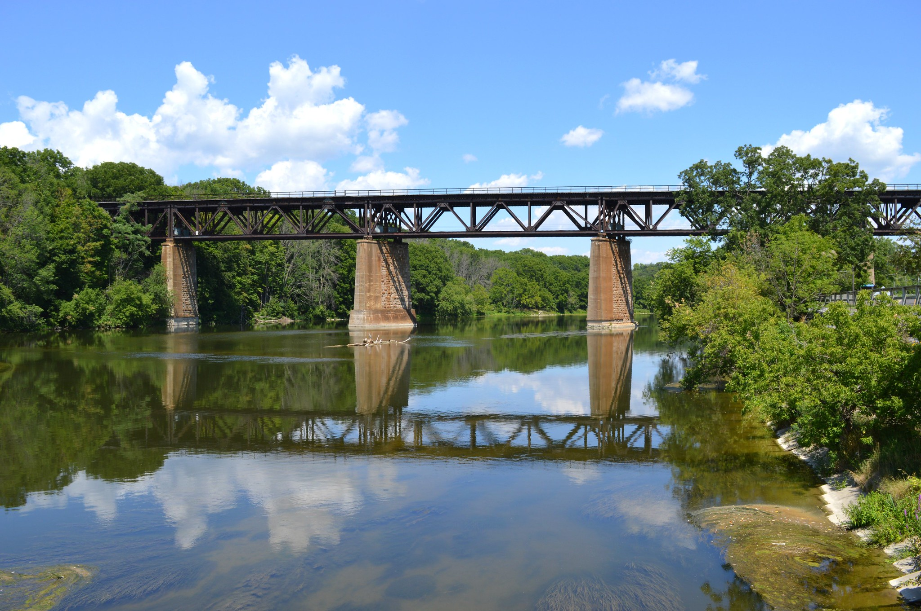
3
Hacking Alma Resource Sharing
Pretty sure it was never intended to be used this way
Alex
Notes:
Paris railway bridge
CN Rail line through Paris, Ontario
Copyright Greg's Southern Ontario August 2016
https://www.flickr.com/photos/57156785@N02/
https://www.flickr.com/photos/57156785@N02/28665472311

Slide 14
Types of Ferries
Alma-to-Alma
ISO Resource Sharing
Email Partners
I took a ferry to the highway
Then I drove to a pontoon plane
I took a plane to a taxi
And a taxi to a train
--Joni Mitchell, "Black Crow"
Works well, but only good between Alma partners that aren’t using other RS products
The classic interaction with partners, requires interoperability
What we have to fall back to for most of our partners. And what we had to hack together

Slide 15
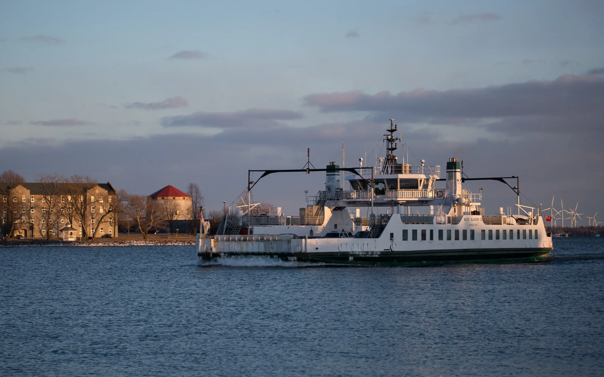
Alma-to-Alma
IT WORKS!
Minimal Config
Locate Profiles
Formats
Out of the box without fighting
Config is simple and minimal
They’re built in!
Physical AND Digital
The Wolfe Island Ferry is a very nice ferry!
--The Arrogant Worms, "Wolfe Island Ferry"
Notes:
MV Wolfe Islander III
Built 1975, 55 cars 294 people, diesel, end loading
Copyright The Ferryman aka Keith Dunn
https://ferryman.ca

Slide 16
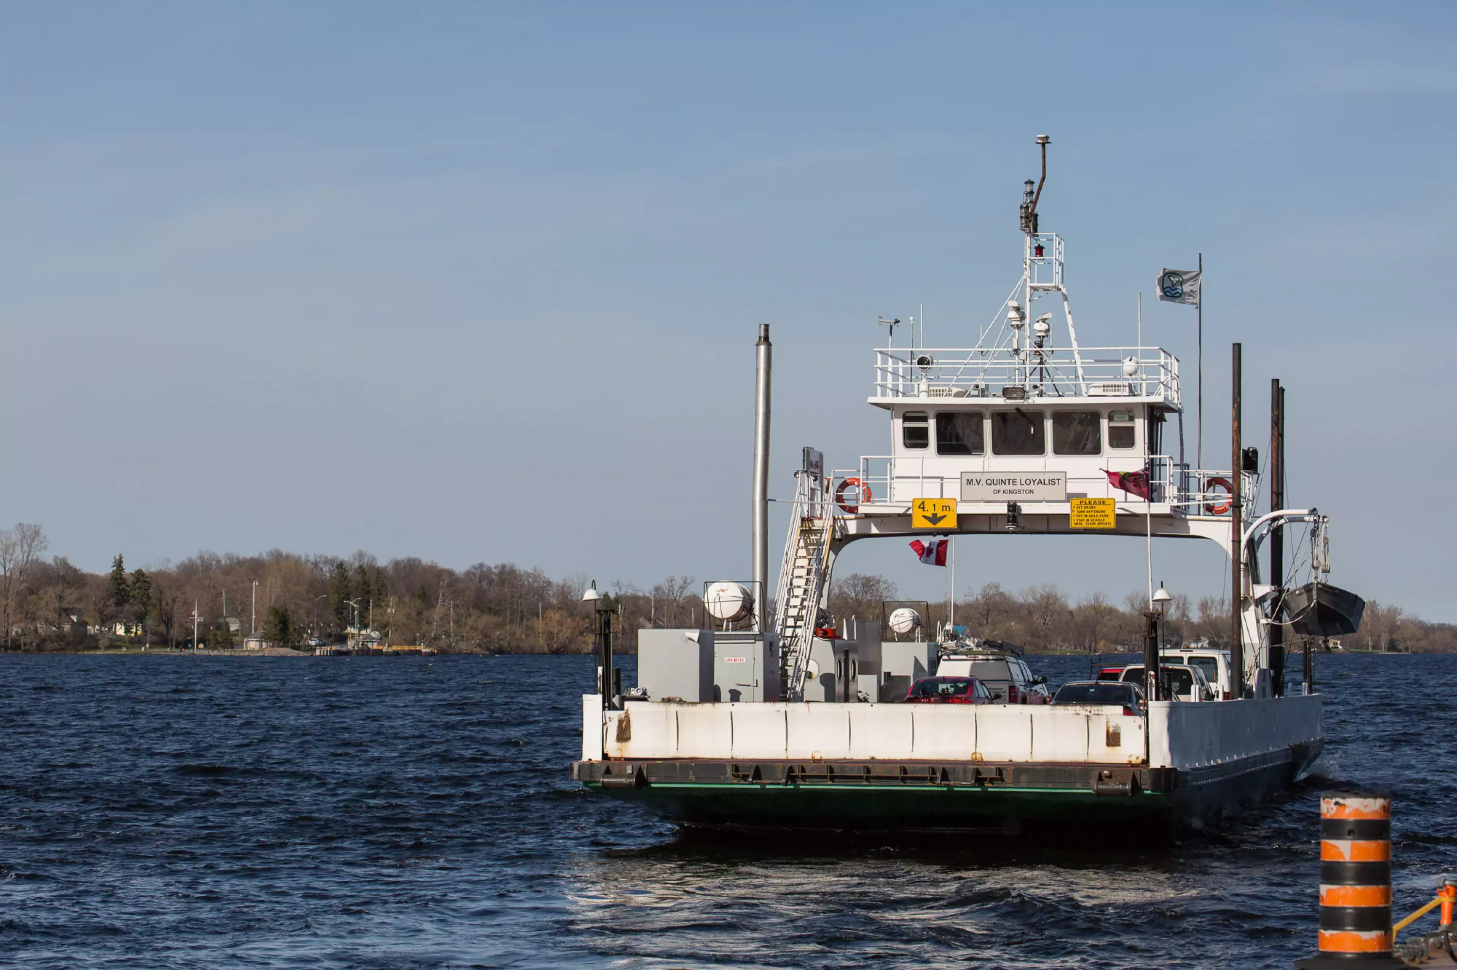
ISO Resource Sharing
It Mostly Works
Minimal Config
Locate Profiles
Formats
It's not perfect, but it works
Config is a bit more involved, but still not horrible and minimal
Ex Libris has to create these for you, we can't create our own
Physical AND Digital
Bridge over troubled water, snow in my muddy water
--Drake, "Under Ground Kings"
Notes:
MV Quinte Loyalist. Christened 1954.
Sister ferry is the MV Glenora, built 1953, modified in 1974 for use on this run.
The Glenora ferry runs between Adolphustown and Glenora, Ontario (gateway to Prince Edward County)
21 cars, diesel, end loading
Copyright The Ferryman aka Keith Dunn
https://ferryman.ca

Slide 17
Email Partners
It... well...
Lots of Config
No Locate Profiles
Formats
Two Workflows?
Letters
You're a bridge to nowhere and you're getting there fast.
--Sam Roberts Band, "Bridge to Nowhere"
Some bits of it work. Others... not how we'd expect
There was a lot of letter work, plus a lot of figuring on workflow
Most don't have ILL systems, so not really relevant...
Physical AND Digital... though born-digital is a challenge
Lending to partners not documented, so created a patron workflow
We had to tinker with so many letters that it felt like we were on Venus

Slide 18
Generally Speaking…
Documentation
LETTERS…
Testing
Staff Challenges
Workflow & configuration documentation lacking
SO… MANY… LETTERS… language / consortial partners
Had to do a lot of testing because of gaps in documentation
Lots of changes; we did these in stages; workflows change a bit each time.
Why'd you have to go and make things so complicated?
--Avril Lavigne, "Complicated"

Slide 19
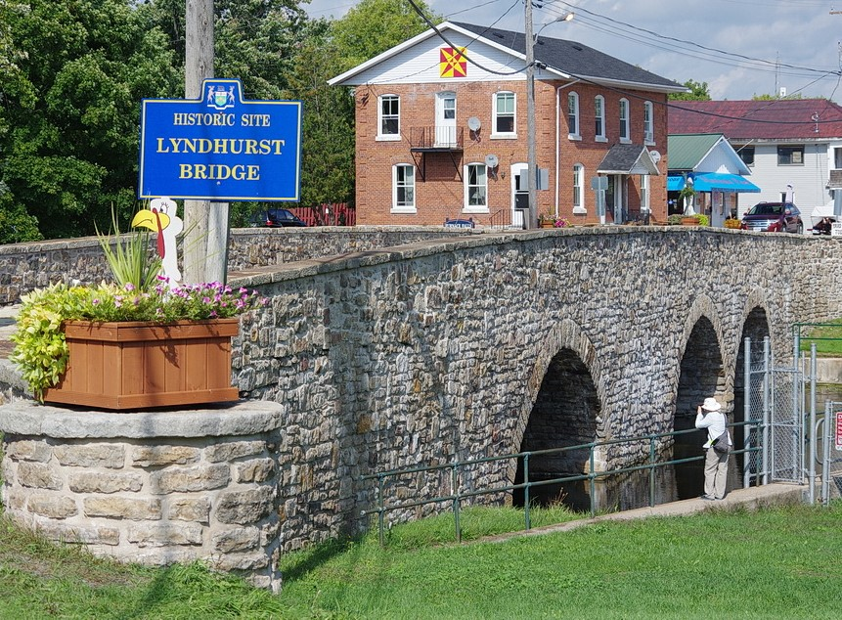
4
What have we learned?
Nothing works the way you think it will.
God damn them all! I was told we'd cruise the seas for American gold. We'd fire no guns, shed no tears...
--Stan Rogers, "Barrett's Privateers"
Randy
Notes:
Lyndhurst Bridge
Lyndhurst, Ontario, built 1857
Copyright Andy Fyon, 2016
Canada (Ontario) Beneath Our Feet
https://www.ontariobeneathourfeet.com/

Slide 20
Test everything
God damn them all! I was told we'd cruise the seas for American gold. We'd fire no guns, shed no tears...
--Stan Rogers, "Barrett's Privateers"
Notes:
Become a person who doesn't trust anything. Especially not written documentation. Not even "trust but verify". Don't trust at all. Test everything yourself. Does it even exist if you didn't see it with your own two eyes? Alma Resource Sharing documentation is funding my therapist's mortgage, is what I'm saying.

Slide 21
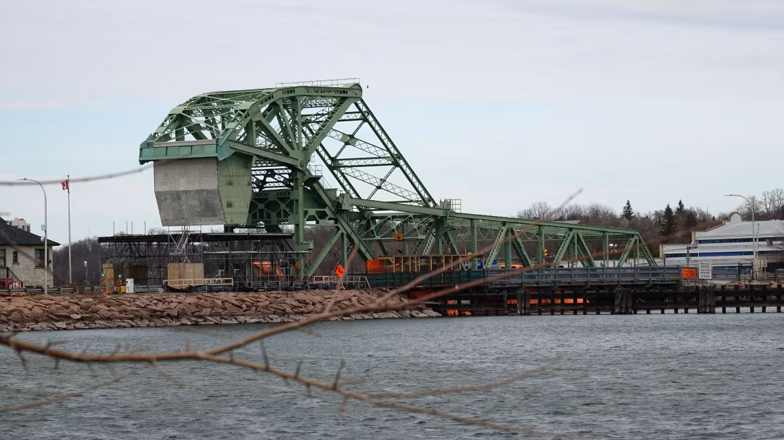
Can we fix the way it works?
Trust no one
Expect the unexpected
Test often…
We always find that we’ve missed a couple of test cases
Ex: how do you invoice for ISO lending requests?
Ex: fines and renewals for ISO borrowing requests
Tickets…tickets…tickets
Enhancement requests
I'se the B'y that builds the boat and
I'se the B'y that sails her and
I'se the B'y that catches the fish...
--Traditional
Notes:
LaSalle Causeway
Kingston, Ontario, over the Cataraqui River. Example of a trunnion bascule lift bridge. Built 1917. Currently closed.
Partially designed by Joseph Strauss who also designed the Golden Gate Bridge.
Copyright Dan Taekema/CBC
https://www.cbc.ca/news/canada/ottawa/kingston-lasalle-causeway-bridge-closed-after-element-compromised-1.7161508

Slide 22
Collaborate
I was in a lifeboat designed for ten, ten only
--The Tragically Hip, "Nautical Disaster"
Sabina

Slide 23
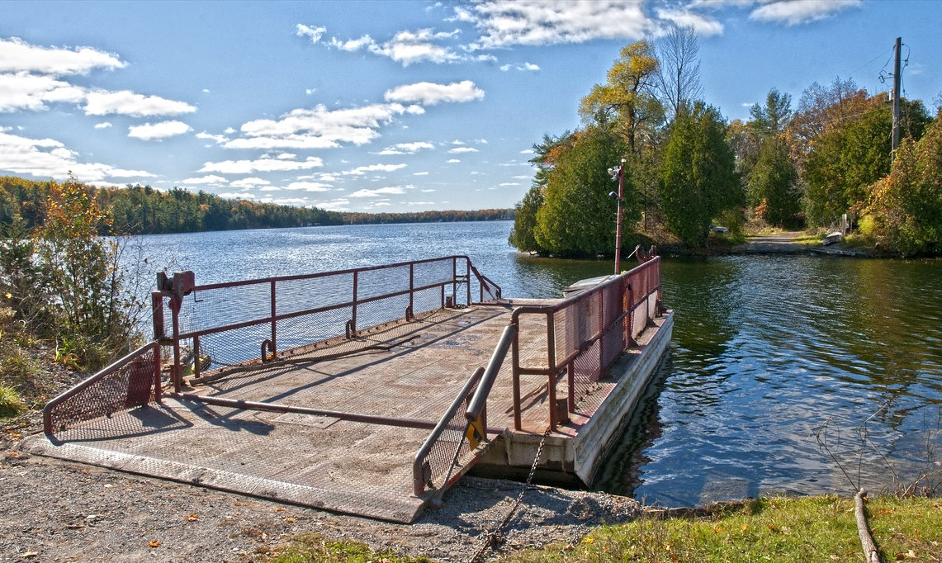
ILL Requires Collaboration
ILL is all about SHARING…
We need to work with other libraries to borrow and lend materials
This requires cross-institution collaboration
This is made A LOT easier by cross-platform compatibility
Without cross platform compatibility, you have to have a lot more person-to-person communication
Many ILL systems cannot communicate with other resource sharing systems…sometimes even if they are owned by the same vendor.
Red button and we'll all go into the river below
--Billy Talent, "River Below"
Notes:
Scott Island Ferry
At the end of Isthmus Road in the Rideau Lakes, Ontario, crossing to Scott Island, Ontario.
Hand propelled by chain, one vehicle barge
Photo copyright Christopher Howitt 2015.
https://www.flickr.com/photos/cjhowitt/
https://www.flickr.com/photos/cjhowitt/22286224369

Slide 24
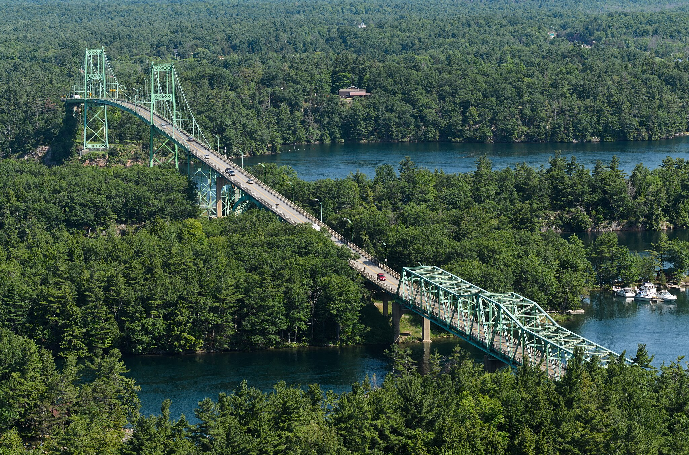
Sharing is caring
ILL is all about SHARING…
We created public pages for documentation and workflows
We created a resource sharing glossary to compare VDX to Alma
We ended up sharing our documentation / training with many other Alma institutions who then implemented ARS from scratch (new partners plus existing ones)
I don't know how we're going to build a castle now
Do you want to start again somehow?
--Carly Rae Jepsen, "Bucket"
Notes:
The Thousand Islands Bridge, Canadian span.
Near Gananoque, Ontario, built 1937. 2M vehicles cross annually.
Two lanes of traffic with pedestrian sidewalks. Canadian span is 410m long.
Copyright Tony (aka King of Hearts, CC BY-SA 4.0)
https://en.wikipedia.org/wiki/Thousand_Islands_Bridge
https://commons.wikimedia.org/wiki/File:Thousand_Islands_Bridge_July_2015_001.jpg

Slide 25
Maple Syrup Speed
You live, you learn
--Alanis Morissette, "You Learn"
Alex

Slide 26
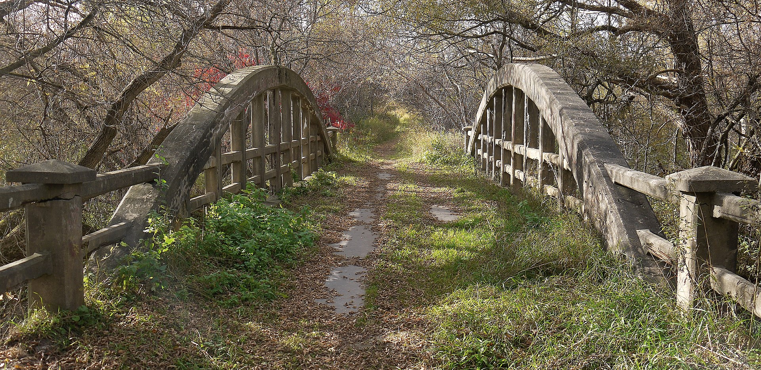
Slower than maple syrup in February
All that testing, all that documentation creation takes time
We often had to re-test over and over and over again
Adding new partners is a process (figure out who to contact to get the partners added on both sides, and arrange testing)
Involving a 3rd party slows things down
It's an uphill climb
--Celine Dion, "That's the Way It Is"
Notes:
McEwan Bridge
Vaughan, Ontario spanning the Humber River. Built 1923, closed to vehicles in the late 1970s.
Single lane, part of the Humber Valley Heritage Trail
Copyright Óðinn, CC BY-SA 2.5 CA 2015
https://en.wikipedia.org/wiki/McEwen_Bridge
https://commons.wikimedia.org/wiki/File:McEwen_Bridge.jpg

Slide 27
Make $$$
Times were hard and though I tried, the money wasn't there
And the bankers came and took my land and told me "fair is fair“
--The Arrogant Worms, “The Last Saskatchewan Pirate”
If I had a million dollars...
--Barenaked Ladies, "If I Had $1,000,000 Dollars"
Randy

Slide 28
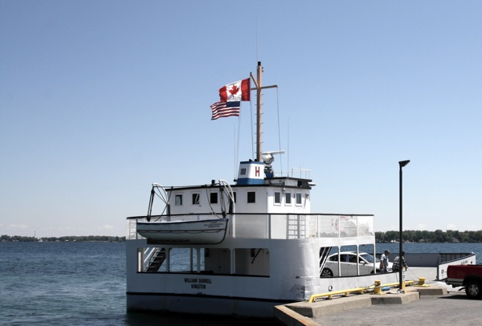
Vendors Care About $$$
Let’s be honest: Vendors care about money…
Vendors make money if you buy/subscribe to their platform
If a vendor locks you to their platform, because their platform can only communication with certain other platforms, then they make money because more people buy their platform…
Many libraries look for net zero ILL…reciprocal…quid pro quo: we’re not making money off ILL
Taking care of business and working overtime
--Bachman-Turner Overdrive, "Takin' Care of Business"
Notes:
Wolfe Island-Cape Vincent ferry. MV William Darrell, built 1952.
12 cars, diesel, side-loader.
Photo copyright Laura Paquet 2016.
https://ottawaroadtrips.com/2018/07/31/7-fun-eastern-ontario-ferries-for-your-next-road-trip/

Slide 29

Thanks!
Does anyone have any questions?
alex.fletcher@ocul.on.ca
roldham@uoguelph.ca
sabina@scholarsportal.info
Nothing lasts forever
--Simple Plan, "Perfect"
Notes:
Click the QR code for the playlist!
https://open.spotify.com/playlist/1kO9JFvYJTyqanH6fUzrnl?si=wdt4lmRmRXe64ww_N1Ch4A&pi=Kl9TfL7VQpel3

